Slide 1
Dissolvable Data
Andy Oh Sean Slavin Baskaran Viswanathan

Slide 2
Quick Facts
USELESS
3 Brains
11 Days
28 hours of brainpower
3 MacBooks
0 Energy Drink
# of Hours Worked on Project
Date | Day | Baskaran | Sean | Andy
9/19 | Tuesday | 3 | 3 | 3
9/20 | Wednesday | 1 | 0 | 1
9/21 | Thursday | 3 | 4 | 3
9/22 | Friday | 0 | 0 | 1
9/23 | Saturday | 4 | 5 | 4
9/24 | Sunday | 2 | 0 | 0
9/25 | Monday | 0 | 2 | 1
9/26 | Tuesday | 4 | 3 | 3
9/27 | Wednesday | 1 | 2 | 1
9/28 | Thursday | 4 | 3 | 3
9/29 | Friday | 4 | 6 | 6
11 Days |  | 26 | 28 | 26

Slide 4
Collaboration Tools

Slide 5
Where to set up a company?

Slide 6
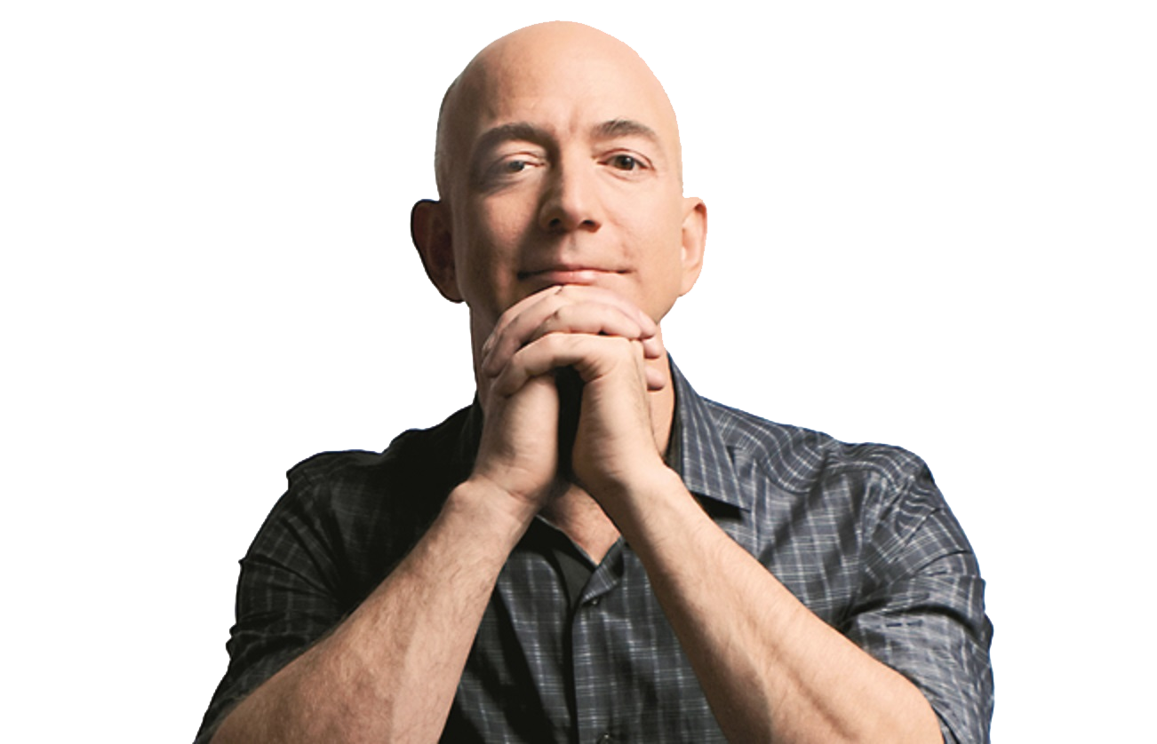
Jeff Bezos
Amazon HQ2
Population ≥ 1,000,000
Major Airport ≤ 45 minutes
City Center ≤ 30 miles
50,000 workers

Slide 7
textio
MarketWatch

Slide 8
Quartz
Brookings Institution

Slide 9
Data Source
U.S. Census Bureau
https://www.census.gov/data.html
U.S. Bureau of Labor Statistics
https://www.bls.gov/data/#api
Google Map API – Distance Matrix
https://developers.google.com/maps/documentation/distance-matrix/
OurAirports
http://ourairports.com/data/

Slide 10
Process
Census Data
Labor Force Data
Airport Data
Distance Matrix

Slide 11
Code

Slide 12
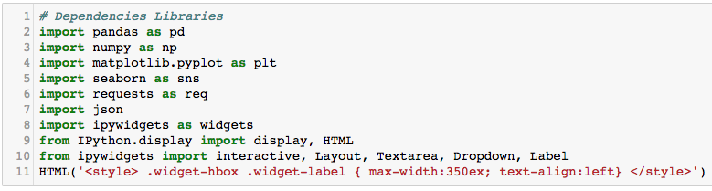

Slide 13
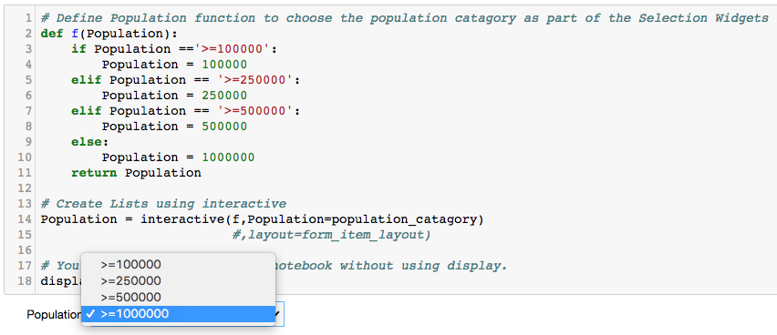

Slide 14
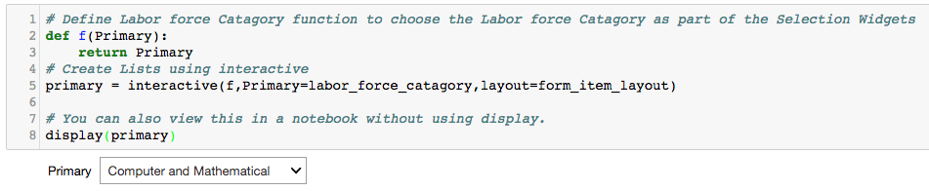

Slide 15
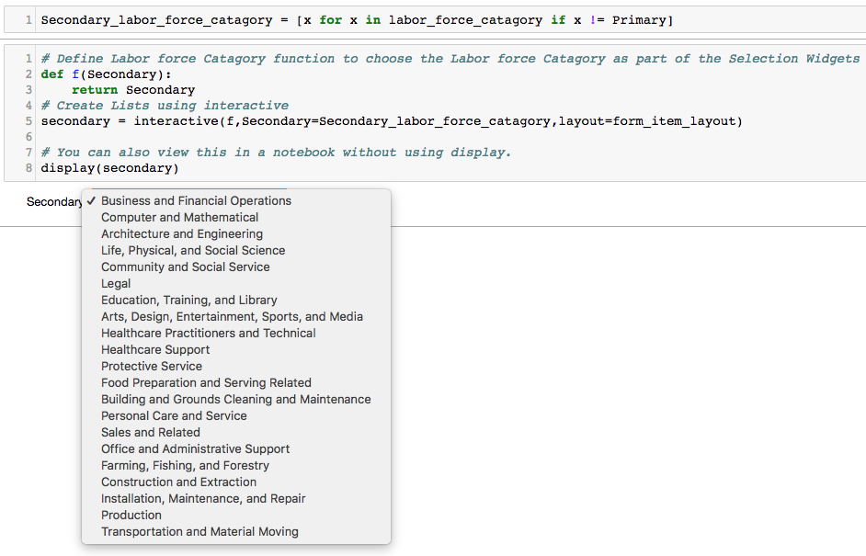

Slide 16
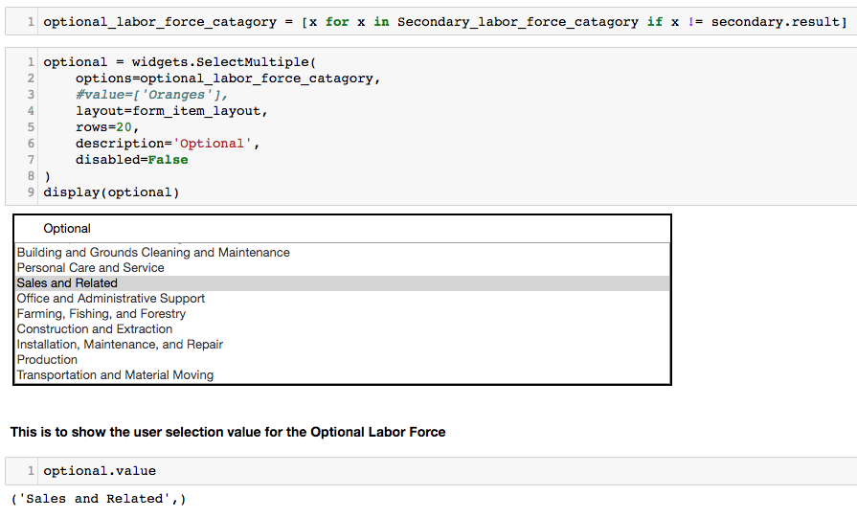

Slide 17
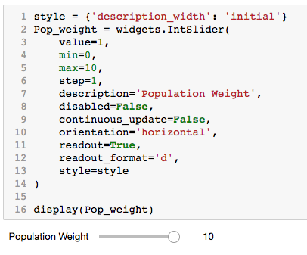
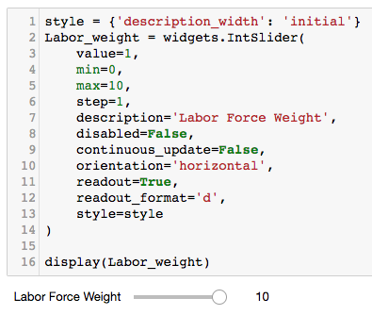

Slide 18
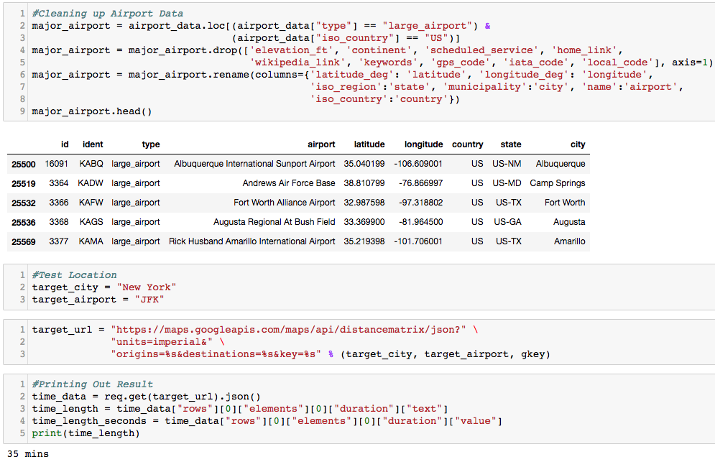

Slide 19
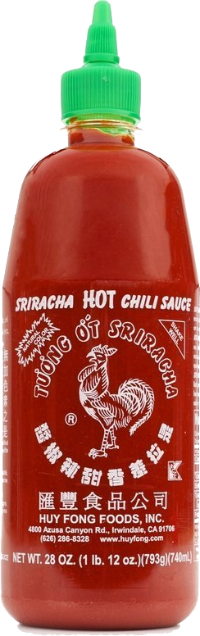
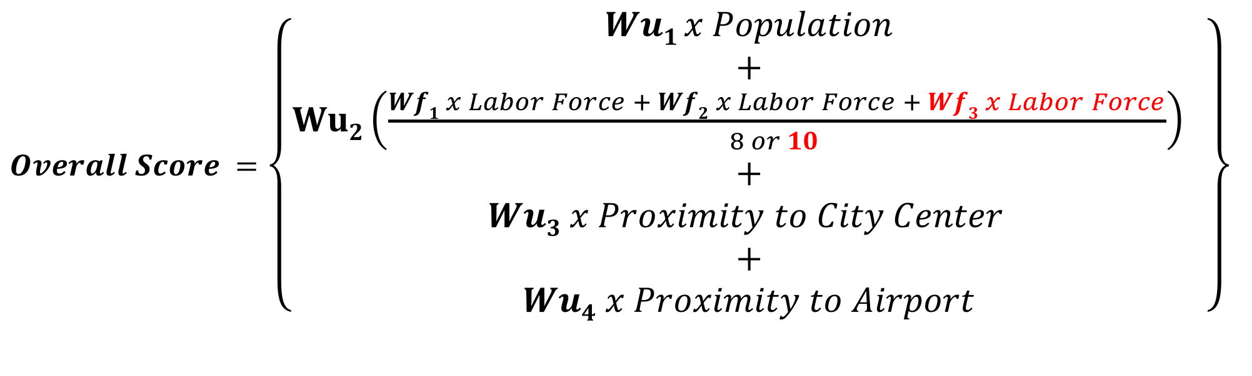
The Secret Sauce
$Overall Score =$ $\left\{\begin{aligned}Wu1 x Population \\ + \\ Wu2\left(\frac{Wf1 x Labor Force + Wf2 x Labor Force + Wf3 x Labor Force}{8 or 10 }\right) \\ + \\ Wu3 x Proximity to City Center \\ + \\ Wu4 x Proximity to Airport\end{aligned}\right\}$
Wu_{1…4} and Wf_{1…3} are weighted values

Slide 20
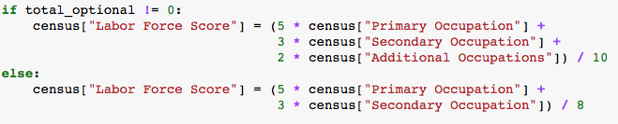
Secret Sauce in Code

Slide 21
Result

Slide 22
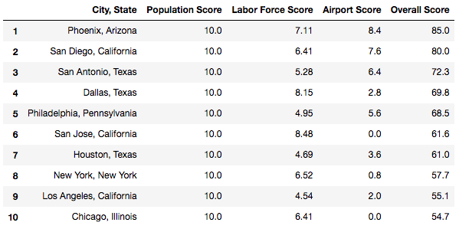

Slide 23

Result Comparisons
Dissolvable Data
# | City
1 | Phoenix
2 | San Diego
3 | San Antonio
4 | Dallas
5 | Philadelphia
Bloomberg
# | City
1 | Toronto
2 | Boston
3 | Washington
4 | Atlanta
5 | Dallas
Quartz
# | City
1 | Salt Lake City
2 | Denver
3 | Boston
4 | Raleigh
5 | Washington DC
MarketWatch
# | City
 | Atlanta
 | Austin
 | Baltimore
 | Boston
 | Bridgeport
CityLab
# | City
1 | Chicago
2 | Dallas
3 | Philadelphia
4 | Atlanta
5 | Phoenix
Textio
# | City
1 | Birmingham
2 | Grand Rapids
3 | Montreal
4 | Salt Lake City
5 | New Orleans

Slide 24
Not bad, right?

Slide 25
Wish List
Accuracy would be greatly improved if we use:
Commercial Real Estate Data
Mass Transit Data
Community Fit/Cultural Diversity Data

Slide 26
Challenge

Slide 27
Questions? Comments?

